Slide 3
They pervert the grace of our God into sensuality and deny our only Master and Lord, Jesus Christ. (4)
The Unrestrained

Slide 4
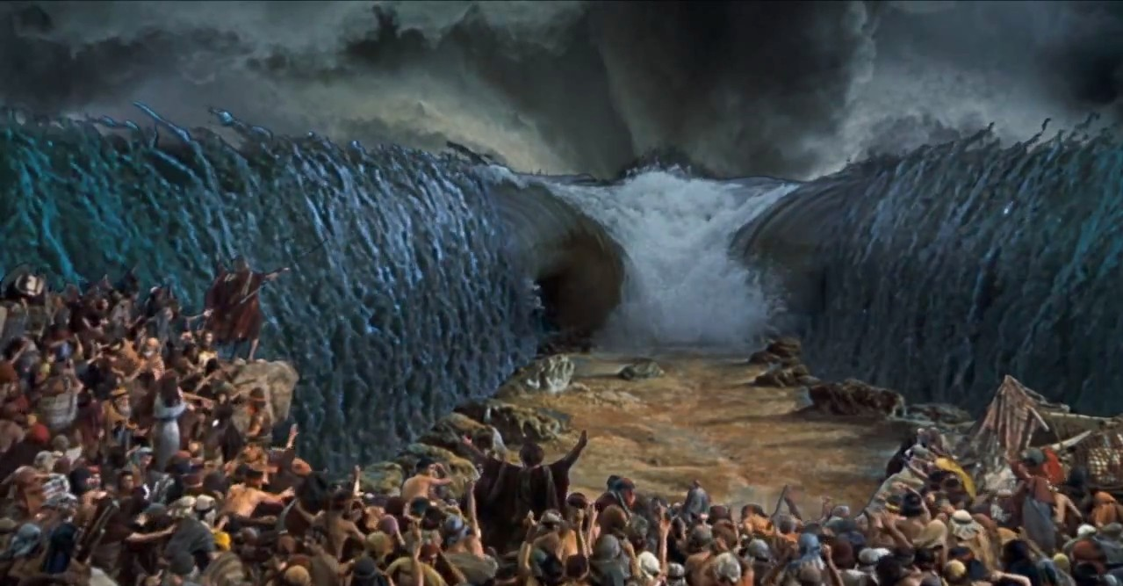
They pervert the grace of our God into sensuality and deny our only Master and Lord, Jesus Christ. (4)
The Unrestrained

Slide 5
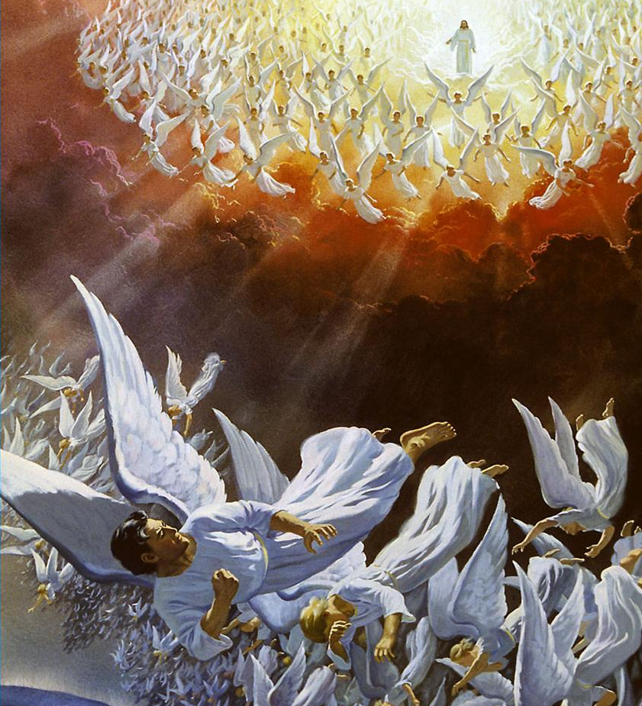
They pervert the grace of our God into sensuality and deny our only Master and Lord, Jesus Christ. (4)
The Unrestrained

Slide 6
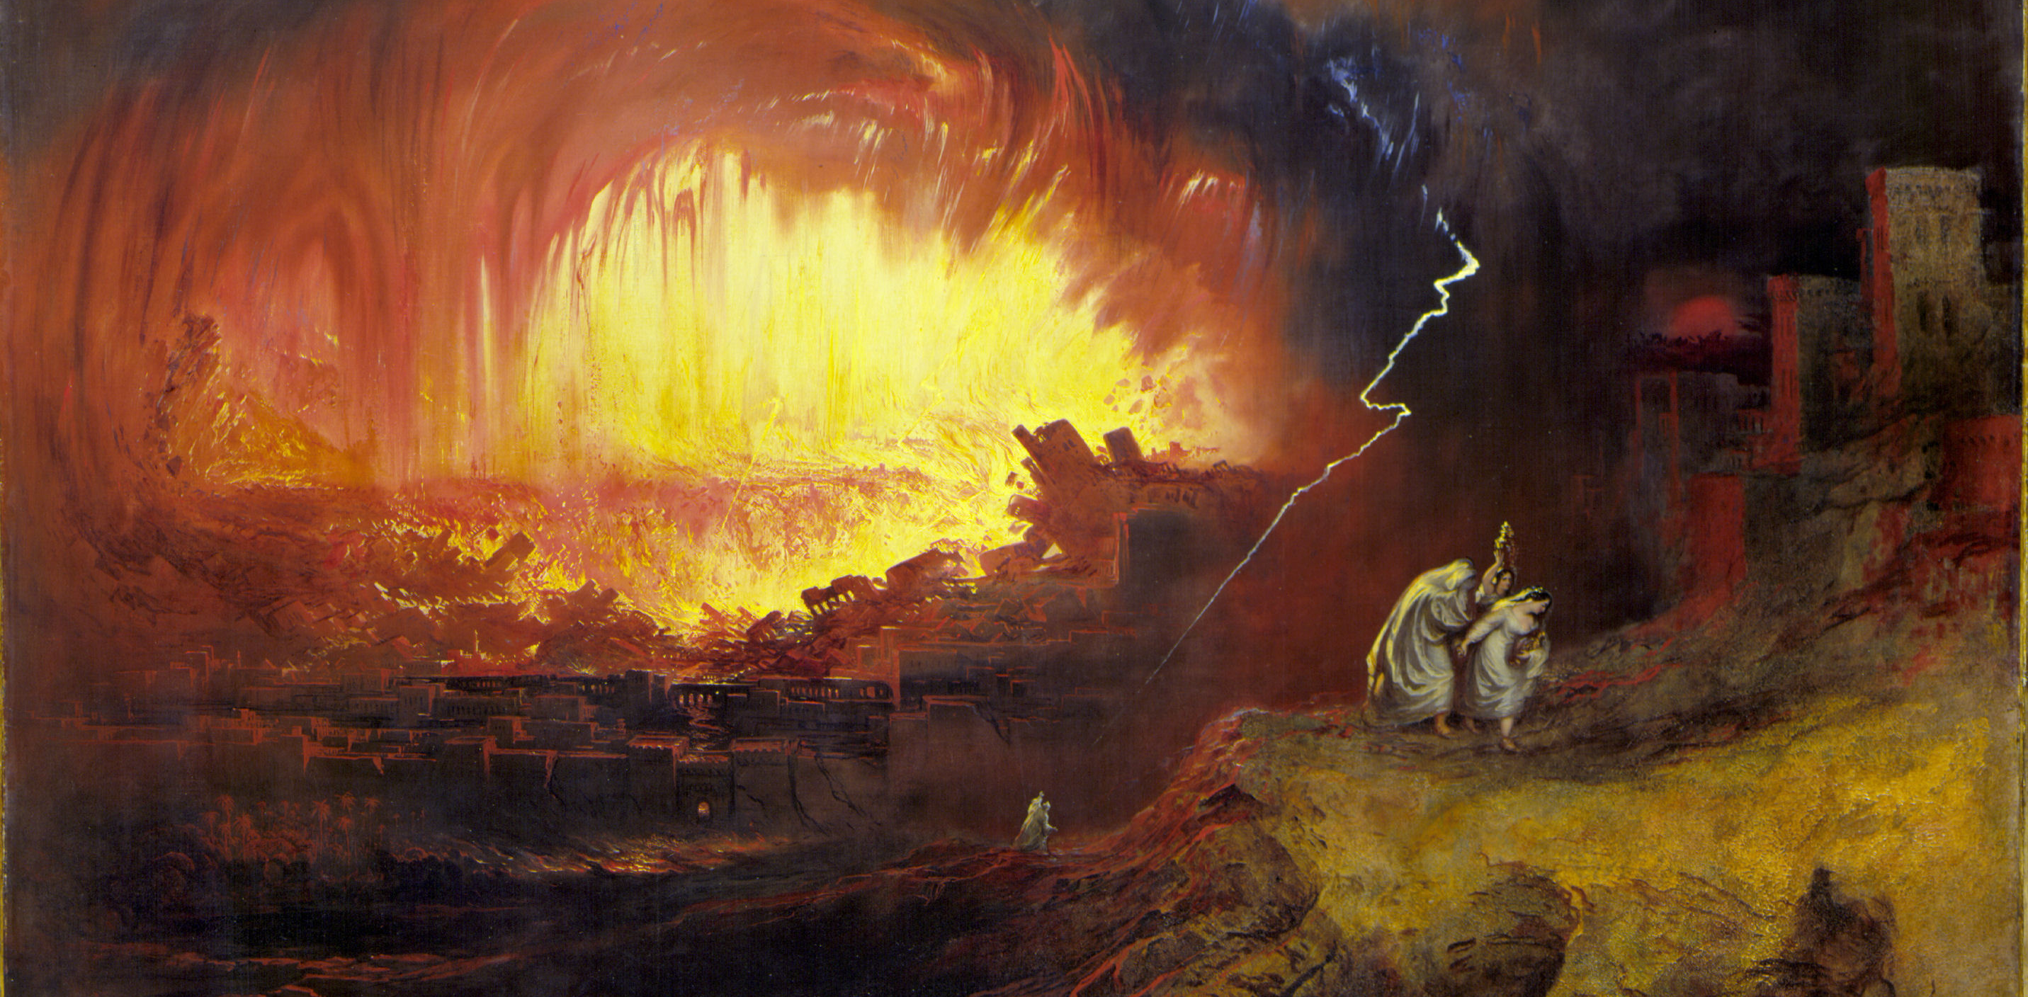
They pervert the grace of our God into sensuality and deny our only Master and Lord, Jesus Christ. (4)
The Unrestrained

Slide 7
These people also, relying on their dreams, defile the flesh, reject authority, and blaspheme the glorious ones. (8)
The Undisciplined

Slide 8
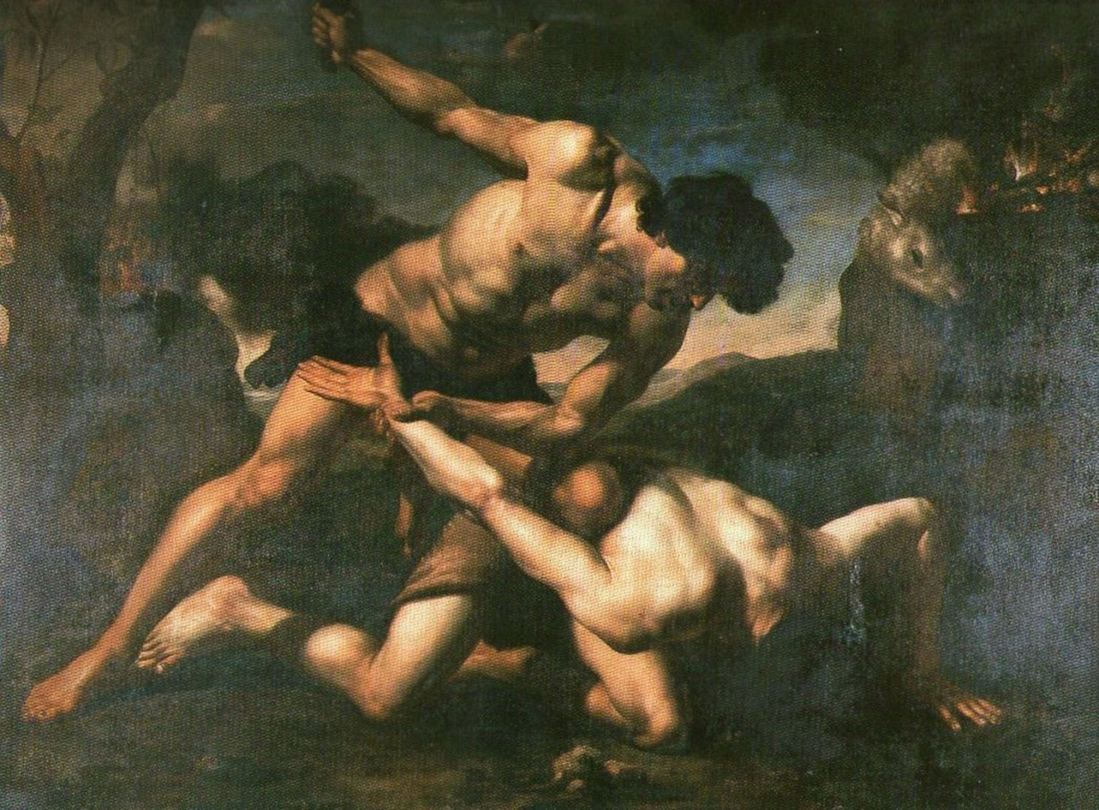
ANGER

Slide 9
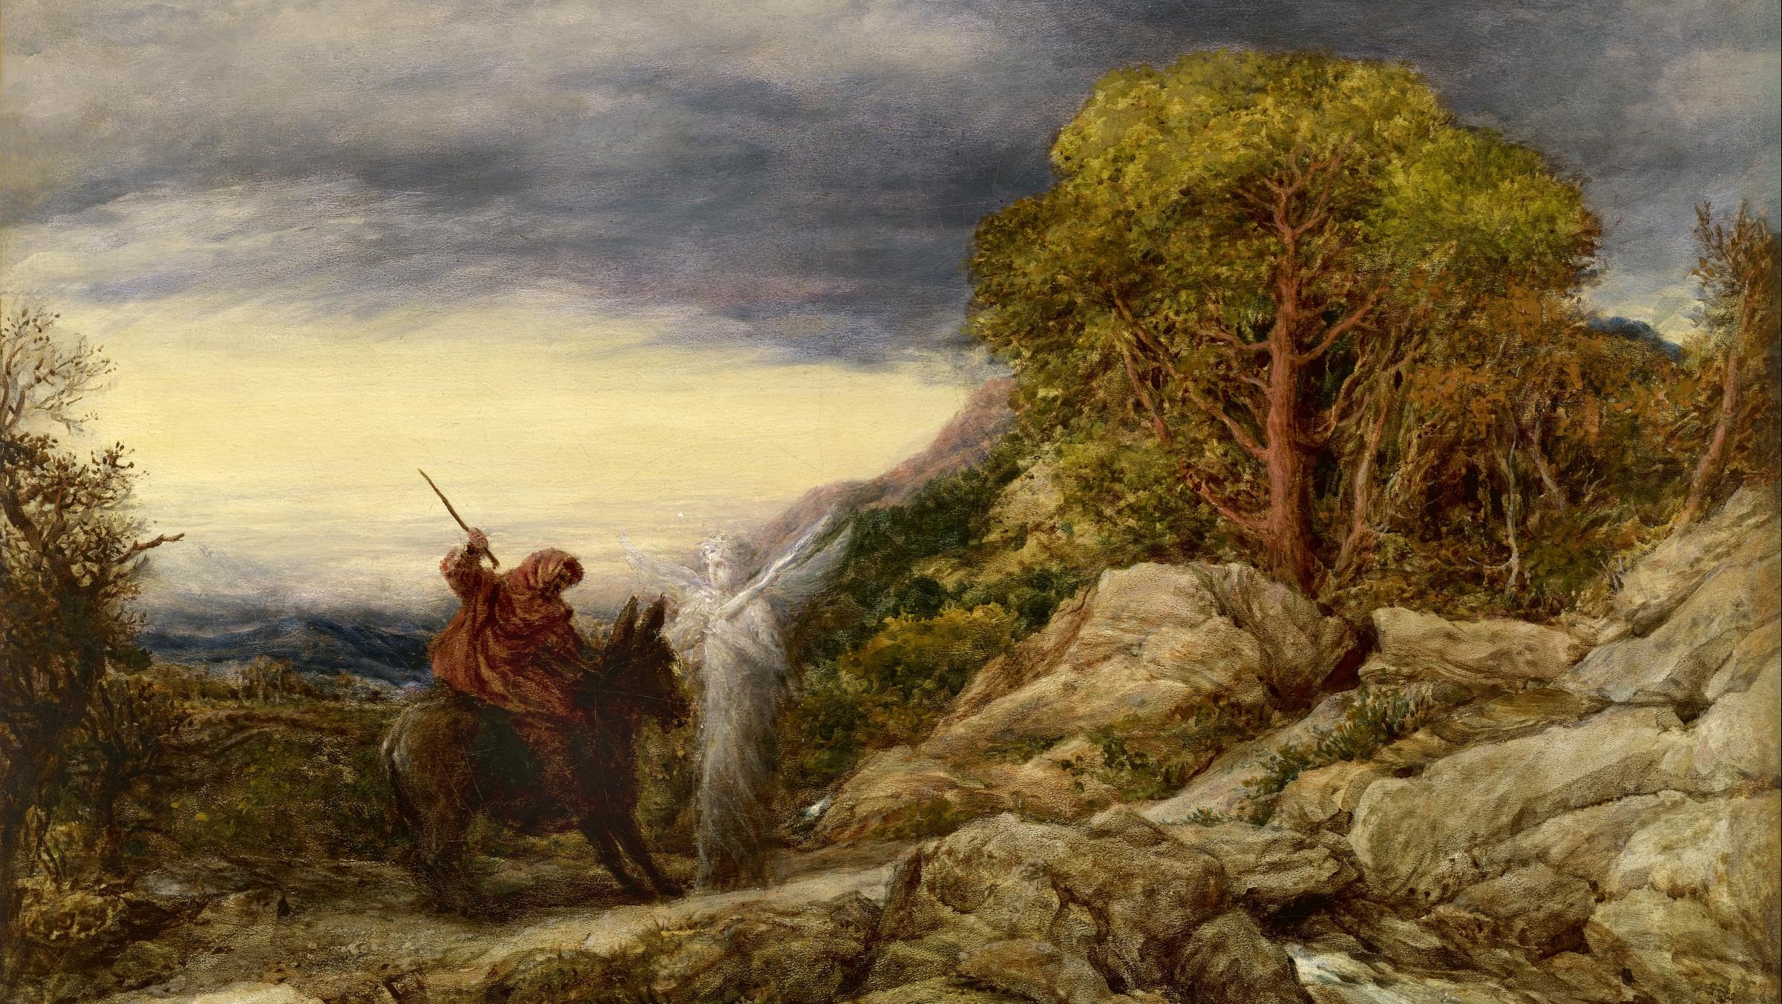
ARROGANCE

Slide 10
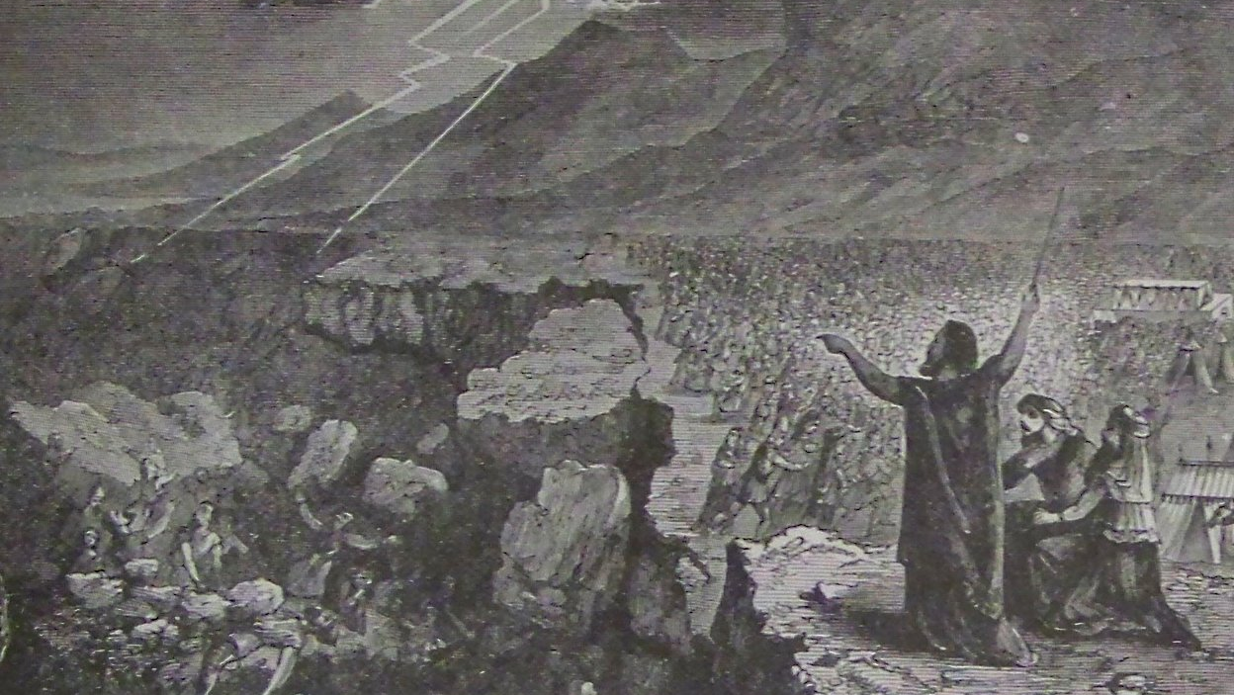
ANARCHY
#notmypresident

Slide 11
These are hidden reefs at your love feasts, as they feast with you without fear, shepherds feeding themselves. (12)
The Unstable

Slide 12
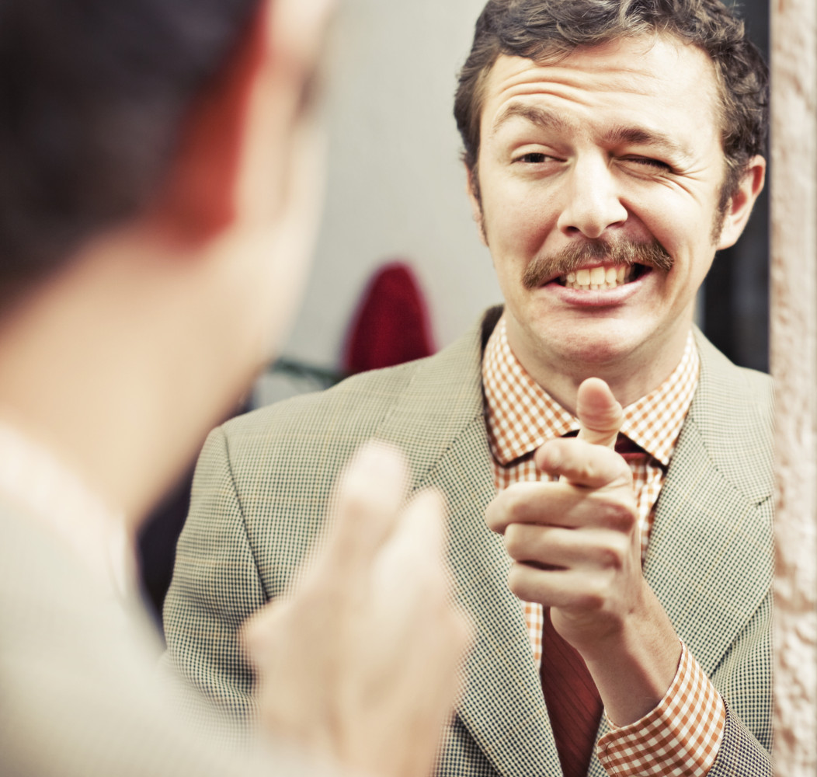
The Lord comes …to convict all the ungodly of all their deeds of ungodliness that they have committed in such an ungodly way, and of all the harsh things that ungodly sinners have spoken against him. (15)
The Ungodly
They are grumblers, malcontents, following their own sinful desires
they are loud-mouthed boasters, showing favoritism to gain advantage

Slide 13
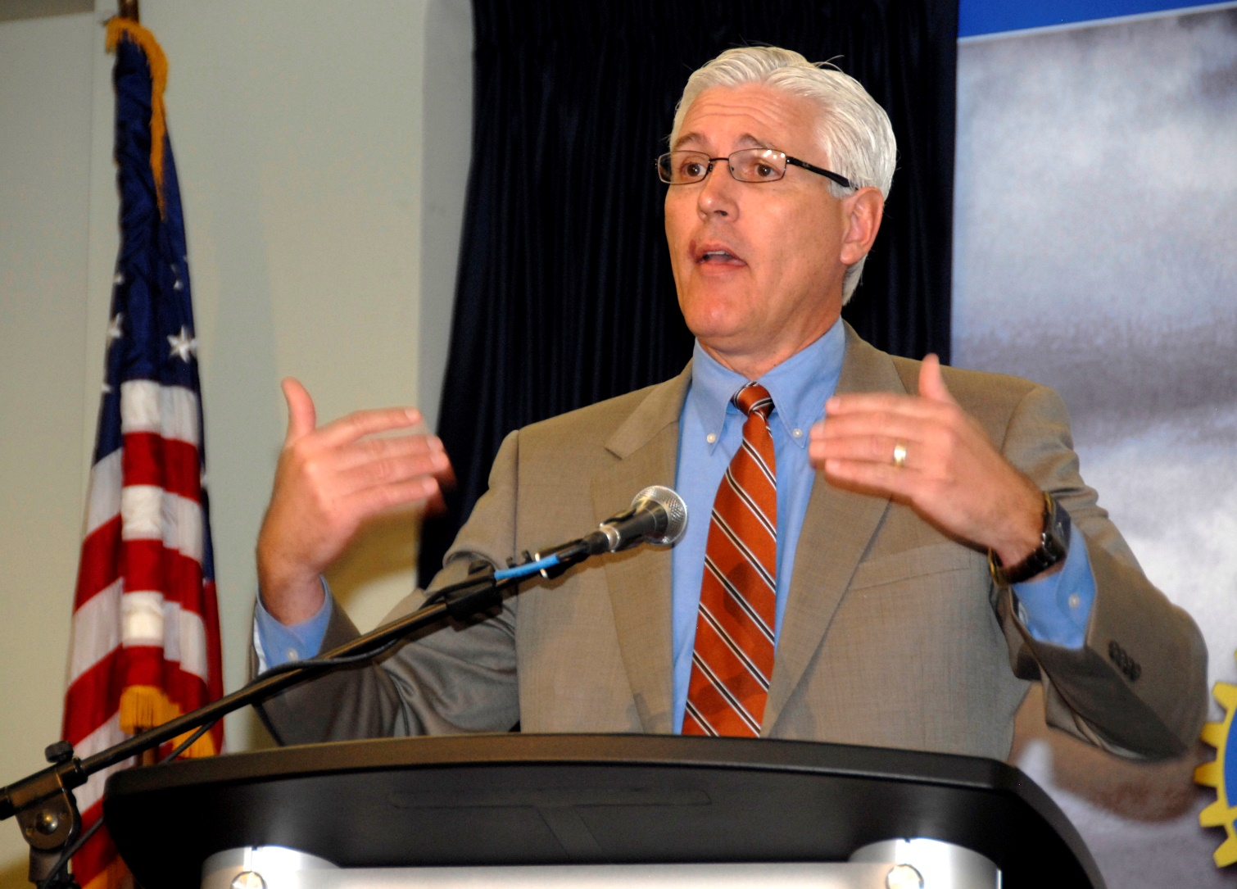
This is Not a Day Care. It’s a University!
Everett Piper, President of Oklahoma Wesleyan University
This past week, I actually had a student come forward after a university chapel service and complain because he felt “victimized” by a sermon on 1 Corinthians 13. It appears this young scholar felt offended because a message on love made him feel bad for not showing love. In his mind, the speaker was wrong for making him, and his peers, feel uncomfortable.
I’m not making this up. Our culture has actually taught our kids to be this self-absorbed and narcissistic. Any time their feelings are hurt, they are the victims. Anyone who dares challenge them and, thus, makes them “feel bad” about themselves, is a “hater,” a “bigot,” an “oppressor,” and a “victimizer.”
I have a message for this young man and all others who care to listen. That feeling of discomfort you have after listening to a sermon is called a conscience. The goal of many a good sermon is to get you to confess your sins—not coddle you in your selfishness. The primary objective of the Church and the Christian faith is your confession, not your self-actualization.

Slide 15
Build yourself up in the faith
Therefore, as you received Christ Jesus the Lord, so walk in him, rooted and built up in him and established in the faith, just as you were taught, abounding in thanksgiving.
- Colossians 2:6-7

Slide 16
Pray in the Holy Spirit
The Spirit helps us in our weakness. For we do not know what to pray for as we ought, but the Spirit himself intercedes for us with groanings too deep for words. … He intercedes for us according to the will of God.
- Romans 8:26-27

Slide 17
Keep yourself in the love of God
If you keep my commandments, you will abide in my love.
- John 15:10

Slide 18
Rescue people
by showing mercy

Slide 21
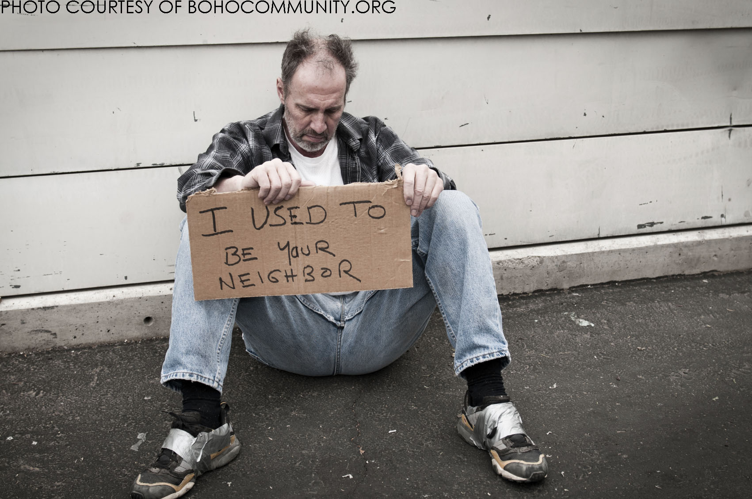
Joshua was standing before the angel, clothed with filthy garments. And the angel said to those who were standing before him, “Remove the filthy garments from him.” And to Joshua he said, “Behold, I have taken your iniquity away from you, and I will clothe you with pure vestments. - Zechariah 3:3-4

