Slide 1
We believe in one God, the Father Almighty, maker of heaven and earth, of all things visible and invisible.
We believe in one Lord Jesus Christ, the only Son of God, begotten from the Father before all ages, He is God from God, Light from Light, true God from true God, begotten, not made; of the same essence as the Father. Through Him all things were made.

Slide 2
For us and for our salvation He came down from heaven; He became incarnate by the Holy Spirit and the virgin Mary, and was made human. He was crucified for us under Pontius Pilate; He suffered and was buried. The third day he rose again, according to the Scriptures. He ascended to heaven and is seated at the right hand of the Father. He will come again with glory to judge the living and the dead. His kingdom will never end.

Slide 3
We believe in the Holy Spirit, the Lord, the giver of life. He proceeds from the Father and the Son, and with the Father and the Son is worshiped and glorified. He spoke through the prophets.
We believe in one holy catholic and apostolic church, and in one baptism for the forgiveness of sins.
We look forward to the resurrection of the dead
and to life in the world to come. Amen.

Slide 4
Peter begins with the Triune God
…according to the foreknowledge of God the Father, in the sanctification of the Spirit, for obedience to Jesus Christ and for sprinkling with his blood

Slide 5
Stay HAPPY

Slide 6
He has caused us to be born again to a living hope through the resurrection of Jesus Christ from the dead, to an inheritance that is imperishable, undefiled, and unfading, kept in heaven for you.
IN THIS you rejoice…
In this you rejoice, though now for a little while, if necessary, you have been grieved by various trials, so that the tested genuineness of your faith— may be found to result in praise and glory and honor at the revelation of Jesus Christ.

Slide 7
He has caused us to be born again to a living hope through the resurrection of Jesus Christ from the dead, to an inheritance that is imperishable, undefiled, and unfading, kept in heaven for you.
Joy inexpressible
Though you have not seen him, you love him. Though you do not now see him, you believe in him and rejoice with joy that is inexpressible and filled with glory, obtaining the outcome of your faith, the salvation of your souls.

Slide 9
Stay HOLY

Slide 10
Set your mind and your hope
on His coming grace
Therefore, preparing your minds for action, and being sober-minded, set your hope fully on the grace that will be brought to you at the revelation of Jesus Christ. As obedient children, do not be conformed to the passions of your former ignorance, but as he who called you is holy, you also be holy in all your conduct.” And if you call on him as Father, conduct yourselves with fear throughout the time of your exile, knowing that you were ransomed … with the precious blood of Christ.

Slide 11
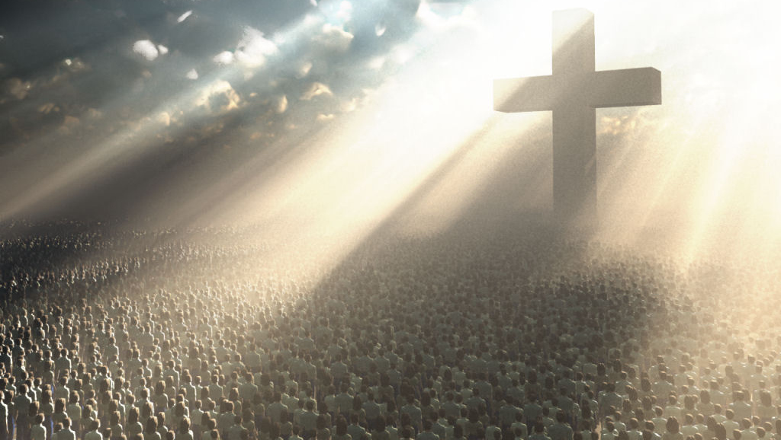
^{2:1} So put away all malice and all deceit and hypocrisy and envy and all slander. Like newborn infants, long for the pure spiritual milk, that by it you may grow up into salvation
^{2:9} You are a chosen race… a people for his own possession, that you may proclaim the excellencies of him who called you out of darkness into his marvelous light.
^{2:11} I urge you as exiles to abstain from the passions of the flesh, which wage war against your soul. ¹² Keep your conduct among the Gentiles honorable, so that when they speak against you as evildoers, they may see your good deeds and glorify God on the day of visitation.
The Church of Jesus Christ

Slide 12
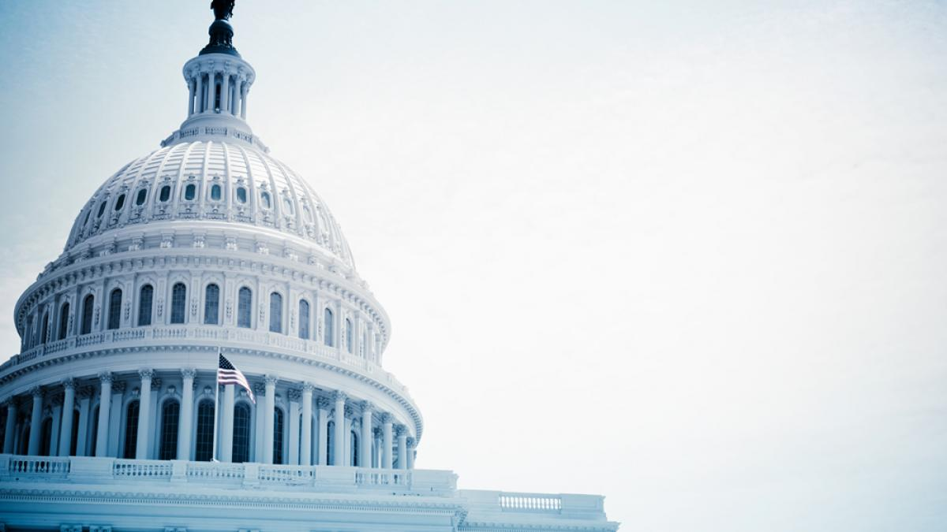
Be subject for the Lord's sake to every human institution, whether it be to the emperor as supreme, or to governors… Live as people who are free, not using your freedom as a cover-up for evil, but living as servants of God. Honor everyone. Love the brotherhood. Fear God. Honor the emperor.
Government leaders

Slide 13
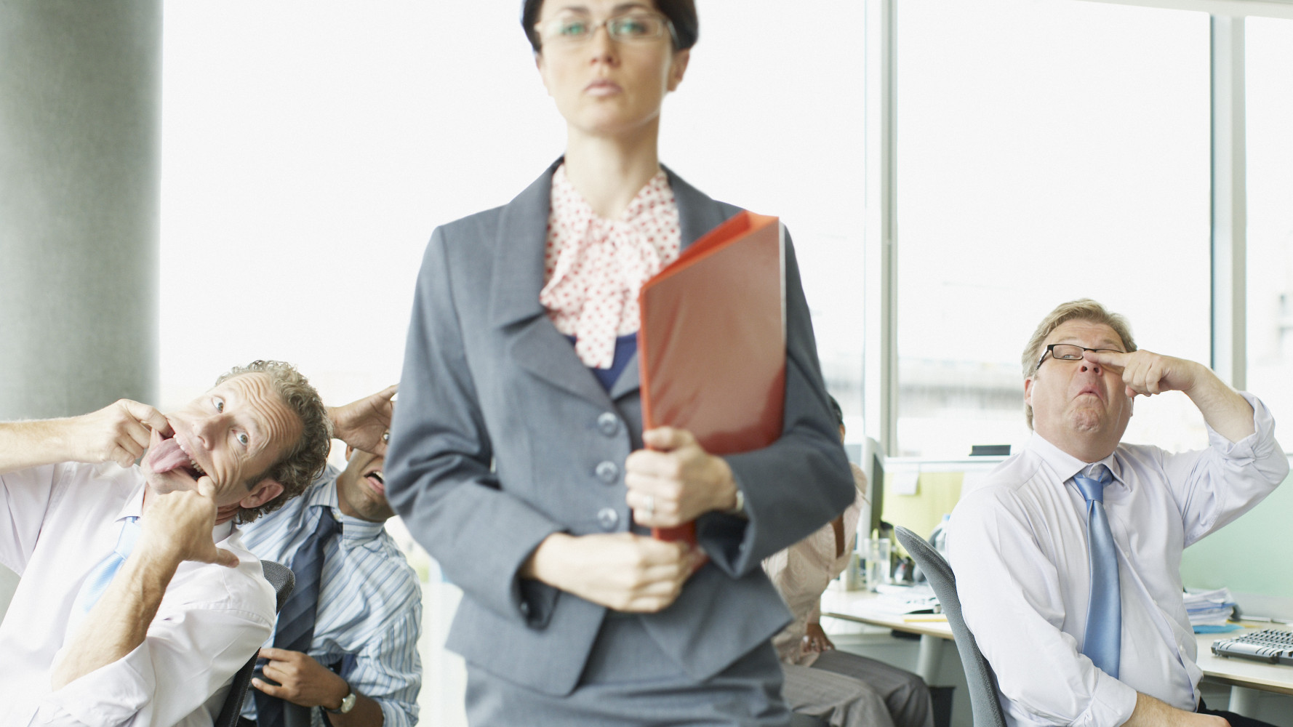
Servants, be subject to your masters with all respect, not only to the good and gentle but also to the unjust. For this is a gracious thing, when, mindful of God, one endures sorrows while suffering unjustly.
For to this you have been called, because Christ also suffered for you, leaving you an example, so that you might follow in his steps.
Bosses

Slide 14
Wives, be subject to your own husbands.
Likewise, husbands, live with your wives in an understanding way
Spouse

Slide 15
⁹ Do not repay evil for evil or reviling for reviling, but on the contrary,
bless, for to this you were called,
that you may obtain a blessing.
¹⁷ For it is better to suffer for doing good,
if that should be God's will, than for doing evil.
¹⁸ For Christ also suffered once for sins, the righteous for the unrighteous, that he might bring us to God, being put to death in the flesh but made alive in the spirit.
Enemies

Slide 16
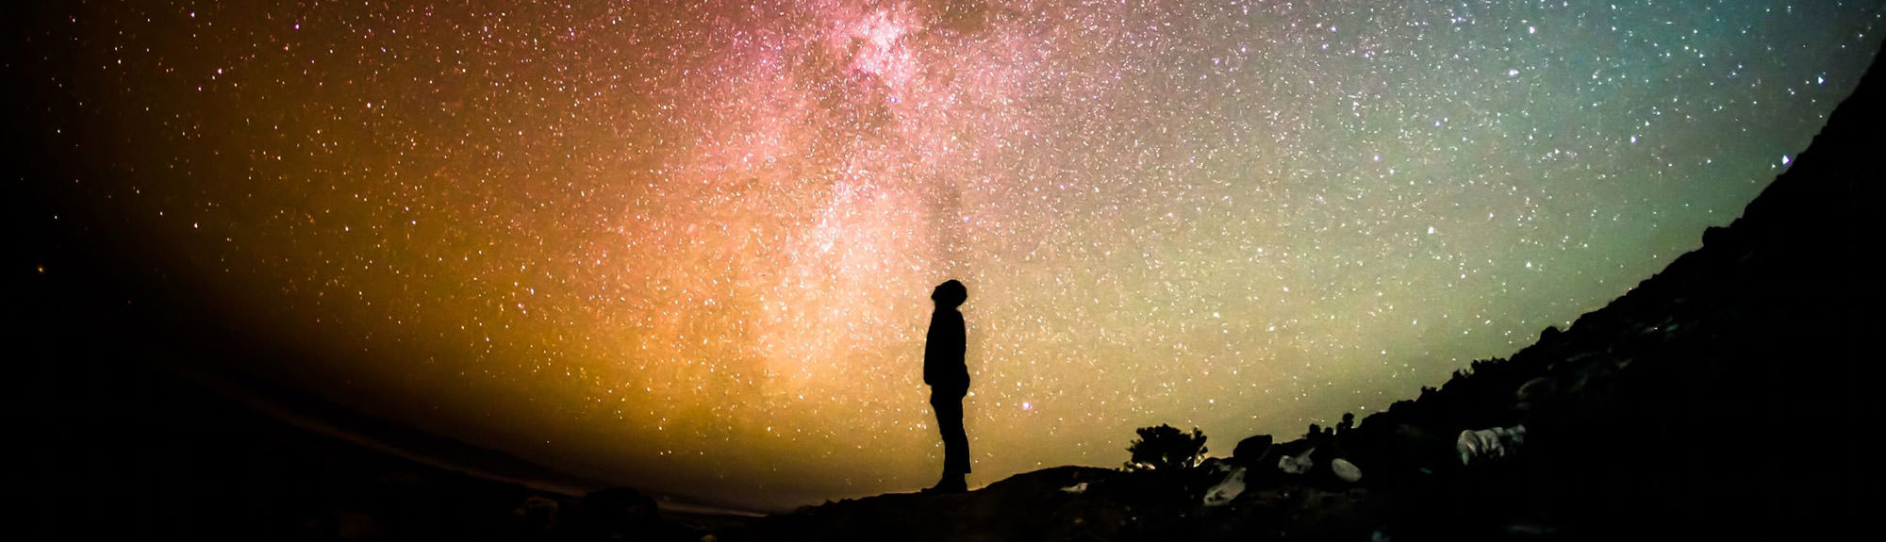
God
Live for the will of God Since Christ suffered in the flesh, arm yourselves with the same way of thinking, for whoever has suffered in the flesh has ceased from sin, so as to live for the rest of the time in the flesh no longer for human passions but for the will of God.

Slide 17
God
Cease from sin For the time that is past suffices for doing what the Gentiles want to do, living in sensuality, passions, drunkenness, orgies, drinking parties, and lawless idolatry. With respect to this they are surprised when you do not join them in the same flood of debauchery, and they malign you.

Slide 18
God
Serve others The end of all things is at hand; therefore be self-controlled and sober-minded for the sake of your prayers. Above all, keep loving one another earnestly, since love covers a multitude of sins. Show hospitality without grumbling. As each has received a gift, use it to serve one another.

Slide 19
God
Glory in the sufferings of Christ Do not be surprised at the fiery trial when it comes upon you to test you, as though something strange were happening to you. But rejoice insofar as you share Christ's sufferings… If anyone suffers as a Christian, let him not be ashamed, but let him glorify God in that name.

Slide 20
Stay HUMBLE
ELDERS be shepherds to the flock of God that is among you …being examples to the flock.
“FLOCK”
be subject to the elders

Slide 21
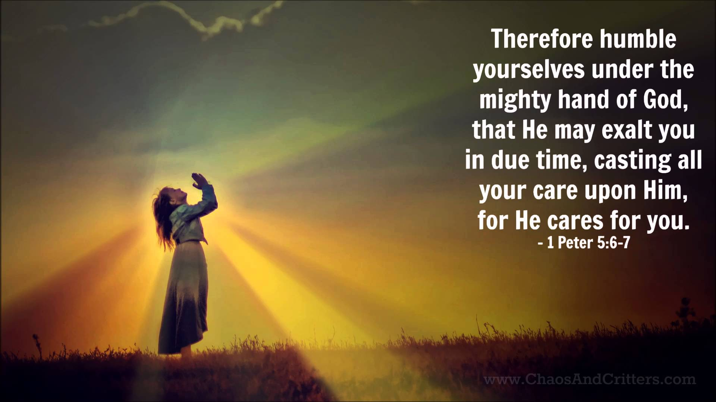

Slide 22
Stay HOPEFUL

Slide 23
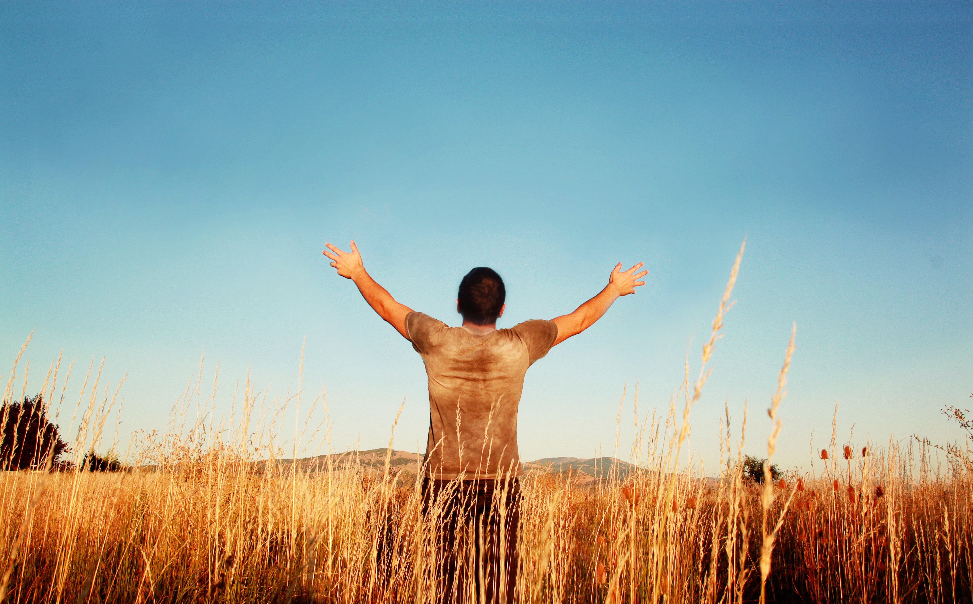
A PROVIDED Faith His divine power has granted to us all things that pertain to life and godliness, through the knowledge of him who called us to his own glory and excellence.
A GROWING Faith Make every effort to supplement your faith with virtue, and virtue with knowledge… self-control… steadfastness… godliness… brotherly affection… love. For if these qualities are yours and are increasing, they keep you from being
ineffective or unfruitful in the knowledge of our Lord Jesus Christ.
Through the knowledge of God

Slide 24
And we have the prophetic word more fully confirmed, to which you will do well to pay attention as to a lamp shining in a dark place, until the day dawns and the morning star rises in your hearts, knowing this first of all, that no prophecy of Scripture comes from someone's own interpretation. For no prophecy was ever produced by the will of man, but men spoke from God as they were carried along by the Holy Spirit.
By the Word of God

Slide 25
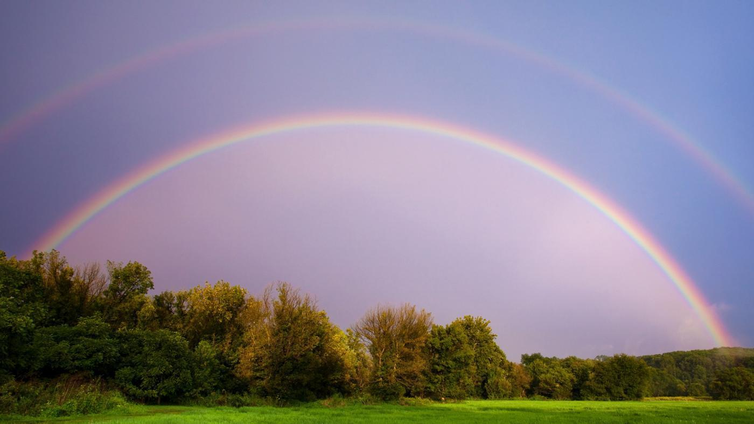
The Lord’s protection and punishment ^{2:9} The Lord knows how to rescue the godly from trials, and to keep the unrighteous under punishment until the day of judgment
In the Promise of God

Slide 26
The Lord’s patience ^{3:9} The Lord is not slow to fulfill his promise as some count slowness, but is patient toward you, not wishing that any should perish, but that all should reach repentance.
In the Promise of God

Slide 27
The Lord’s coming ^{3:11-13} Since all these things are thus to be dissolved, what sort of people ought you to be in lives of holiness and godliness, waiting for and hastening the coming of the day of God… According to his promise we are waiting for new heavens and a new earth in which righteousness dwells.
In the Promise of God

