Slide 2
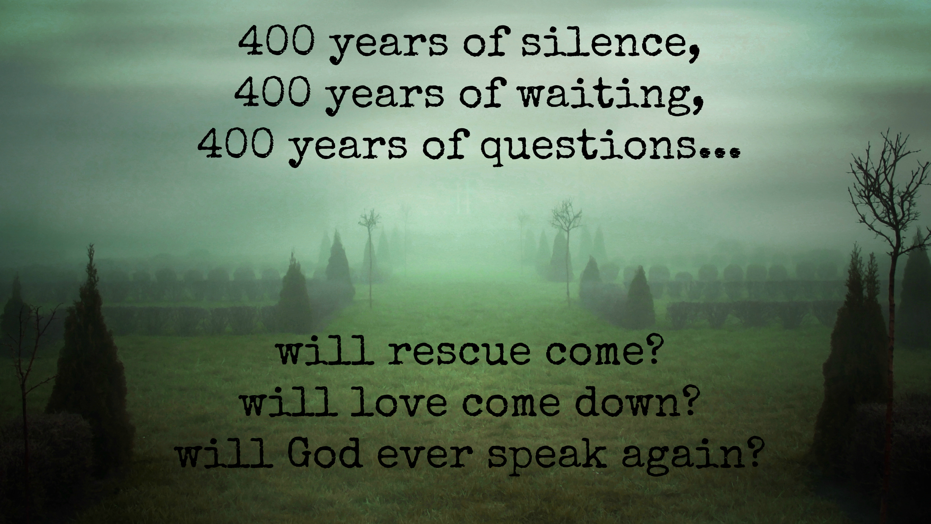

Slide 3
Audience: Jews
Lineage: Jesus is in the line of Abraham
Focus: Jesus is the fulfillment of the O.T.
Do not think that I have come to abolish the Law or the Prophets; I have not come to abolish them but to fulfill them. - Mt. 5:17

Slide 4
Audience: Romans (Gentiles)
Lineage: None - - “son of Mary” (6:3)
Focus: Jesus’s actions in serving others

Slide 5
Audience: Greeks
Lineage: …son of Adam, son of God
Focus: Jesus is the God-man
who came to save

Slide 6
Audience: Christians (Jews & Gentiles)
Lineage: Jesus was with God in the beginning
I do not need the
Focus: God shows His love through Jesus

Slide 9
He is like a refiner’s fire and like fullers’ soap
- Malachi 3:2

Slide 11
Jesus came.
God SEEKS the lost

Slide 13
When he saw the crowds, he had compassion for them, because they were harassed and helpless, like sheep without a shepherd. - Mt. 9:36
Jesus loved.
God SERVES the lost

Slide 14
Jesus died and rose again.
God SAVES the lost

Slide 15
Sinners are called to repent and be born again
Matthew 4:17 Repent, for the kingdom of heaven is at hand.
Mark 1:15 The time is fulfilled, and the kingdom of God
is at hand; repent and believe in the gospel.
Luke 5:32 I have not come to call the righteous but sinners to repentance.
John 3:3 Unless one is born again he cannot see the kingdom of God.”

Slide 16
Go.
Serve.
Baptize.

