Slide 1
DANIEL

Slide 2
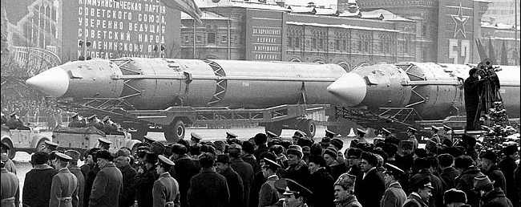

Slide 3
Psalm 118:8-9
It is better to take refuge in the LORD than to trust in man.
It is better to take refuge in the LORD than to trust in princes.

Slide 4
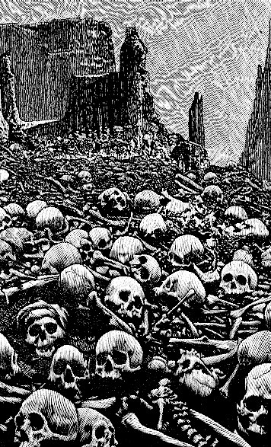
We believe in God the Father
We believe in Jesus Christ
We believe in the Holy Spirit
And He’s given us new life
We believe in the crucifixion
We believe that He conquered death
We believe in the resurrection
And He’s coming back again,
We believe

Slide 5
We believe in God the Father
We believe in Jesus Christ
We believe in the Holy Spirit
And He’s given us new life
We believe in the crucifixion
We believe that He conquered death
We believe in the resurrection
And He’s coming back again,
We believe
So, let our faith be more than anthems,
Greater than the songs we sing
And in our weakness and temptations
We believe, we believe!
He’s coming back again!

Slide 6
Daniel recounts the time of exile in Babylon and the Persian conquest
~605 to 535 BC Prophesy (Christ & His return)
6 chapters 6 chapters
4000+
1400
930
722
539
400
1445
1405
1050
586
Exodus
ASSYRIA
conquers
Israel
Proverbs
Esther
Psalms
Judges
EXILE
Captives in Babylon
Numbers
Nehemiah
Genesis
Northern Kingdom (10 Tribes): Israel
Joshua
Ecclesiastes
Ezra
Leviticus
Southern Kingdom (2 Tribes): Judah
Ruth
Song of Songs
Isaiah
Jer / Lam
1 & 2 Samuel
Ezekiel
Job
DANIEL
Deuteronomy
1 & 2 Kings
1 & 2 Chronicles
Egypt Assyria Babylon Persia

Slide 7
We believe in God the Father
We believe in Jesus Christ
We believe in the Holy Spirit
And He’s given us new life
We believe in the crucifixion
We believe that He conquered death
We believe in the resurrection
And He’s coming back again,
We believe
In the here and now, let love invade
Let the church live loud our God we’ll say
We believe, we believe!
And the gates of hell will not prevail!
For the power of God has torn the veil!

Slide 8
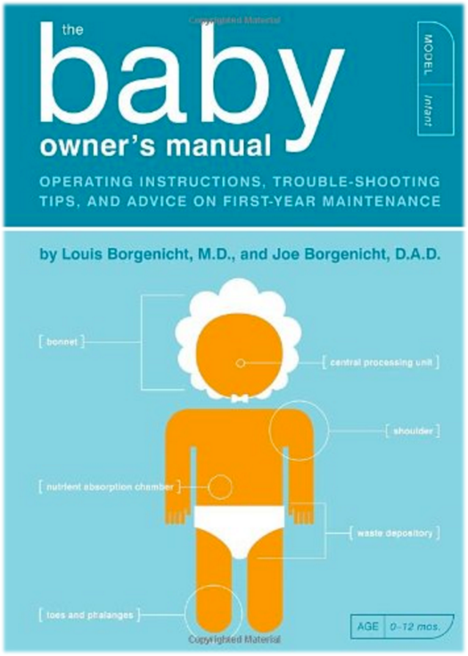

Slide 9
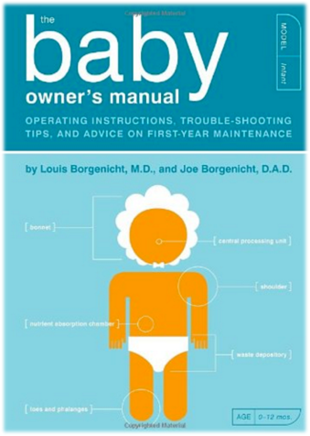
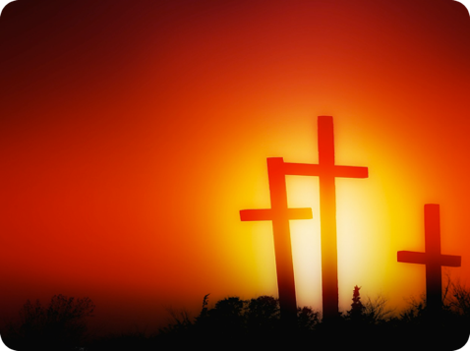
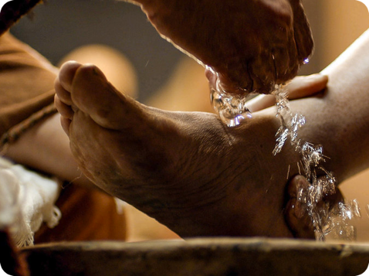
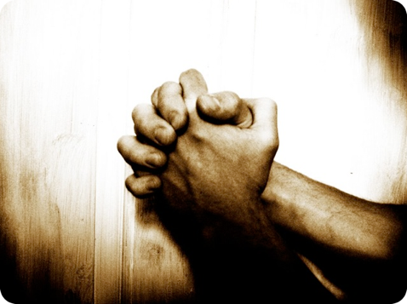
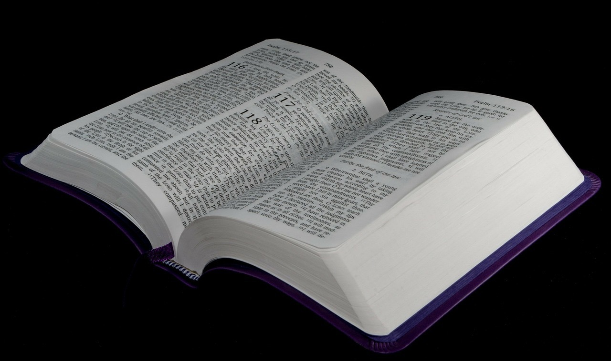
Luke 24:25
“Oh foolish ones, and slow of heart to believe all that the prophets have spoken!”

Slide 10
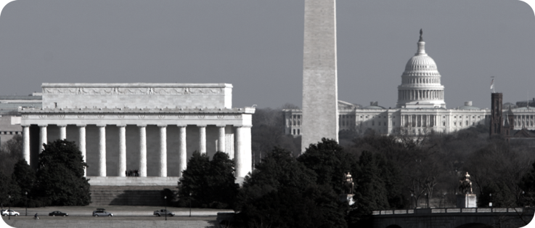
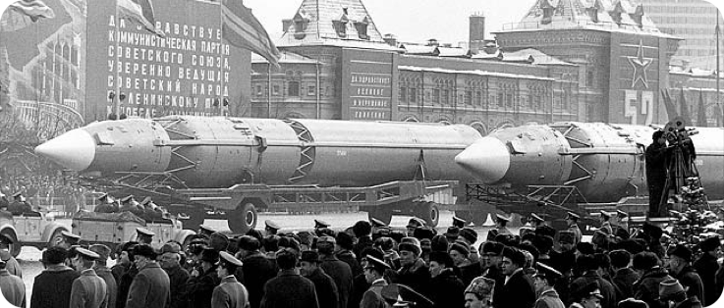
Daniel 4:17
“So the living may know that the Most High is sovereign over the kingdoms of men…”

Slide 11
Daniel 1:15
“At the end of ten days they were better in appearance and fatter in flesh than all the youths who ate the king’s food.”
Daniel 4:17
“So the living may know that the Most High is sovereign over the kingdoms of men…”

Slide 12
Daniel 2:17-18
“Then Daniel went to his house and made the matter known to his companions and told them to seek mercy from the God of heaven concerning this mystery.”
Daniel 2:20
“Blessed be the name of God forever and ever,
to whom belong
wisdom and might.”
Daniel 4:17
“So the living may know that the Most High is sovereign over the kingdoms of men…”

Slide 13
Daniel 3:10
You, O king, have made a decree, that every man who hears the sound of the horn, pipe… and every kind of music, shall fall down and worship the golden image.

Slide 14
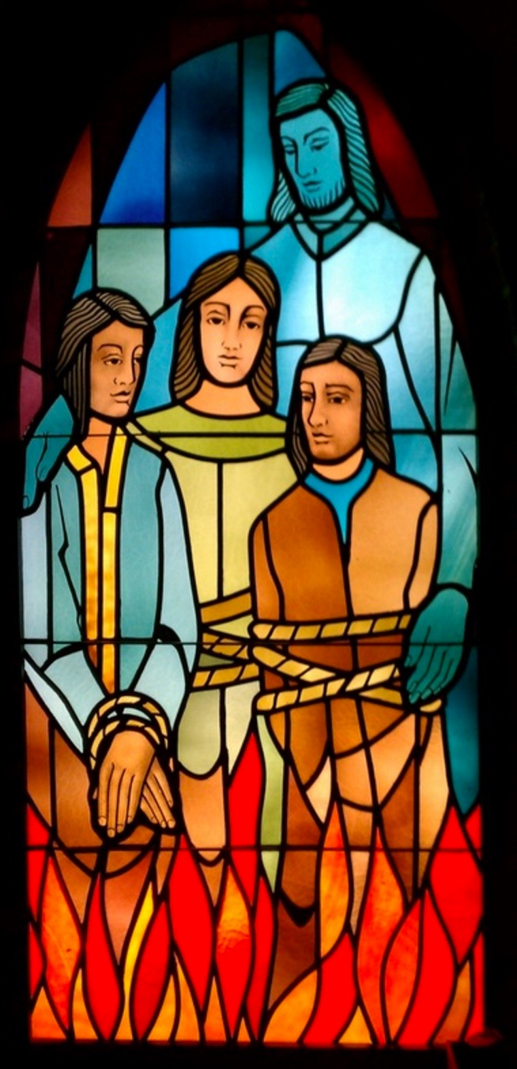
Daniel 3:10
You, O king, have made a decree, that every man who hears the sound of the horn, pipe… and every kind of music, shall fall down and worship the golden image.
Daniel 3:16-18
“O Nebuchadnezzar, we have no need to answer you in this matter. If this be so, our God whom we serve is able to deliver us from the burning fiery furnace, and he will deliver us out of your hand, O king. But if not, be it known to you, O king, that we will not serve your gods or worship the golden image that you have set up.”

Slide 15
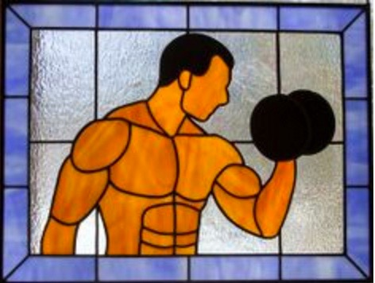
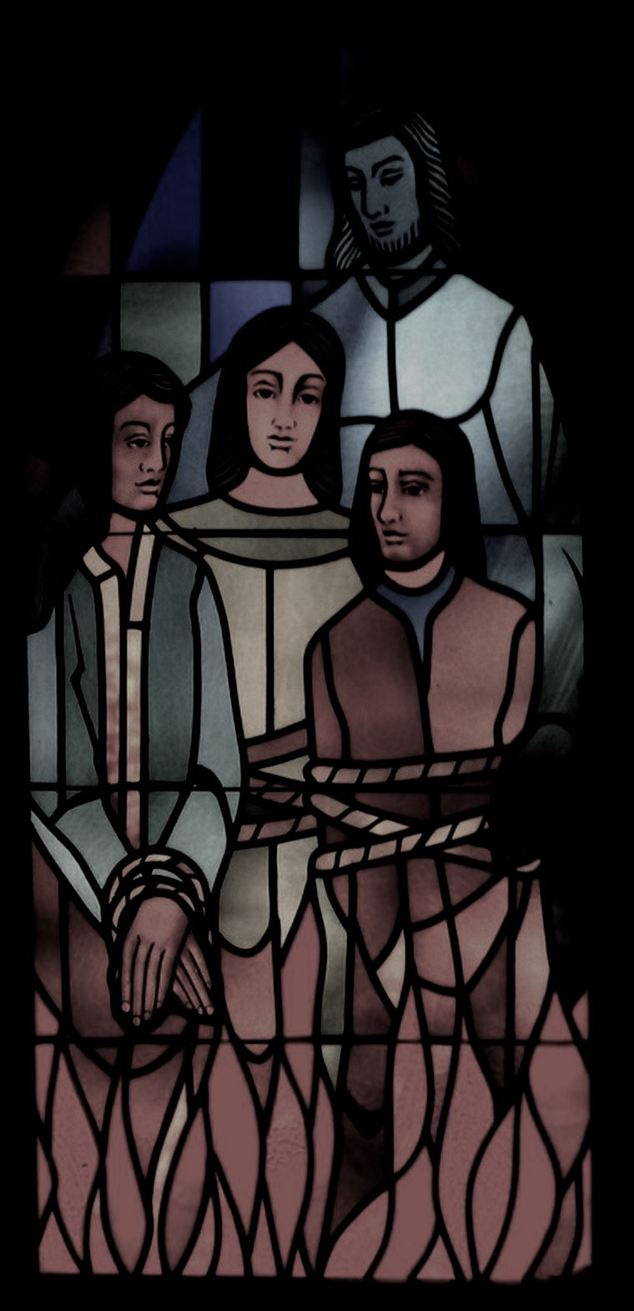
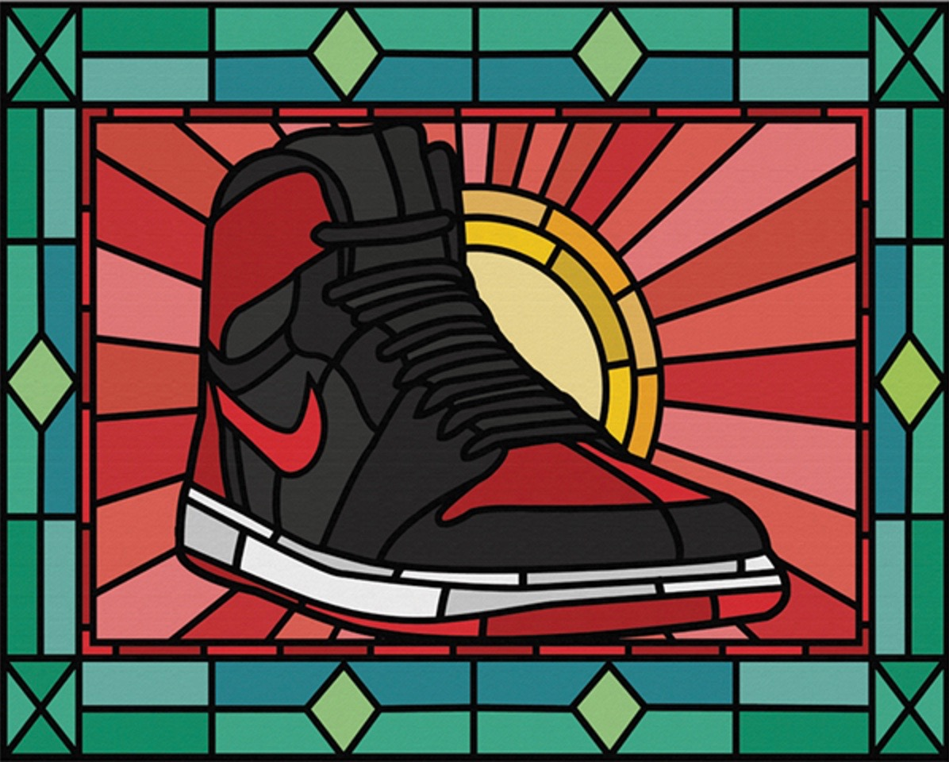
Daniel 3:18
“…be it known to you, O king, that we will not serve your gods or worship the golden image that you have set up.”

Slide 16
Daniel 4:34
At the end of the days I, Nebuchadnezzar, lifted my eyes to heaven, and my reason returned to me, and I blessed the Most High, and praised and honored him who lives forever, for his dominion is an everlasting dominion, and his kingdom endures from generation to generation.
Romans 10:9
If you confess with your mouth that Jesus is Lord and believe in your heart that God raised him from the dead, you will be saved.

Slide 17
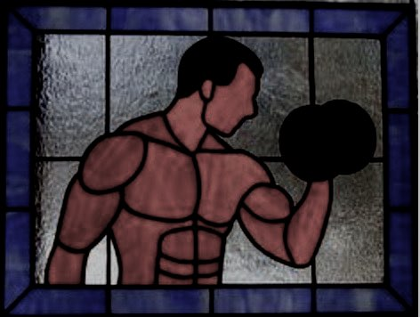
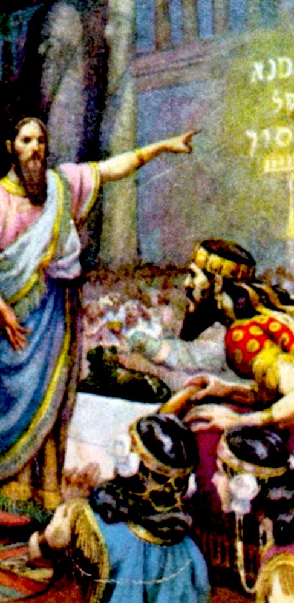
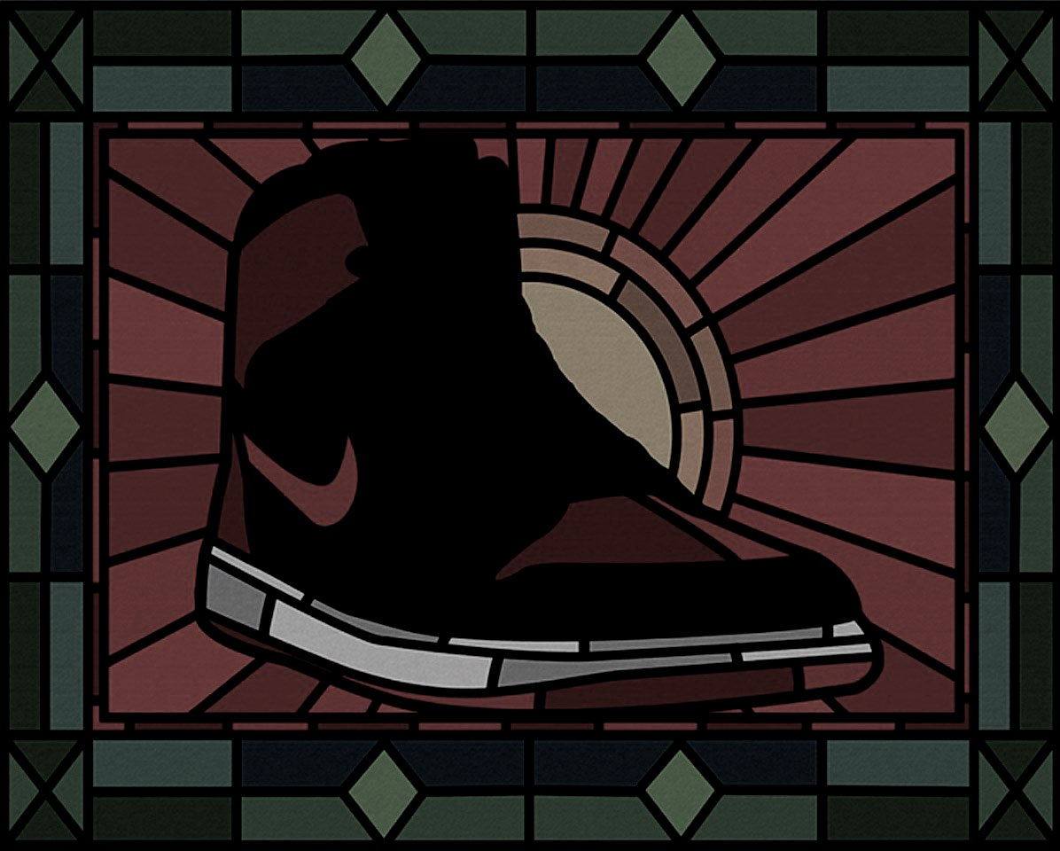

Slide 18
Daniel 5:27
“Tekel, you have been weighed in the balances and found wanting.”

Slide 19
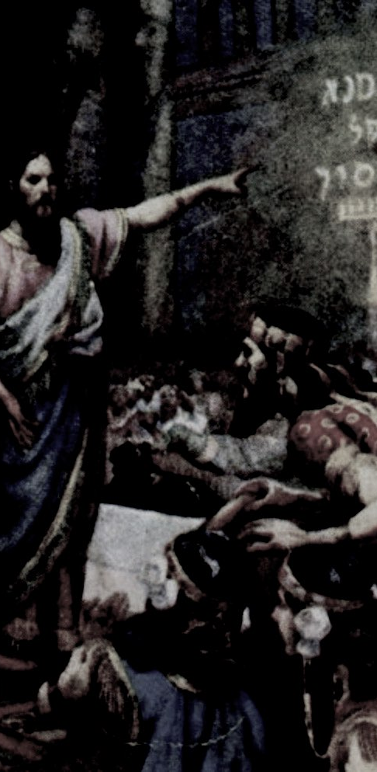
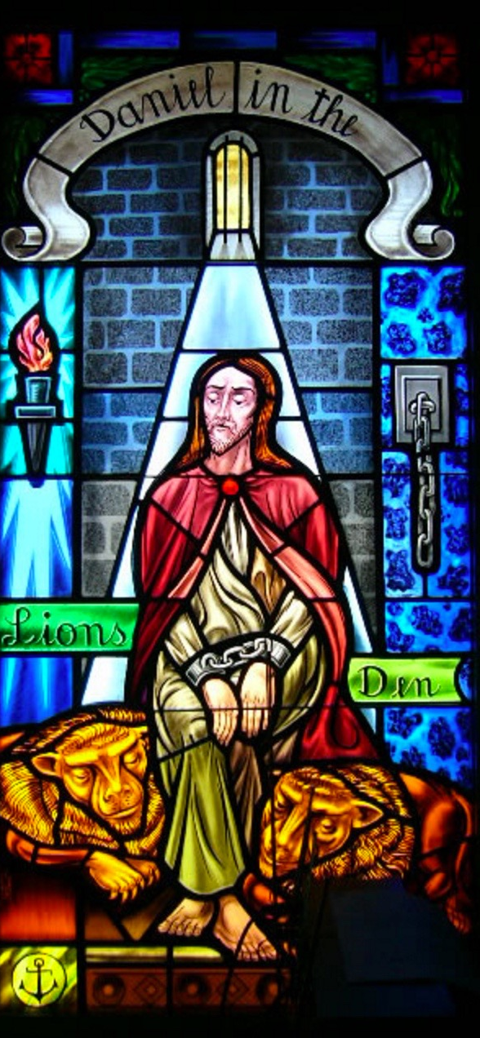

Slide 20
Daniel 6:10
When Daniel knew that the document had been signed, he went to his house where he had windows in his upper chamber open toward Jerusalem. He got down on his knees three times a day and prayed and gave thanks before his God, as he had done previously.
Daniel 6:10
When Daniel knew that the document had been signed, he went to his house where he had windows in his upper chamber open toward Jerusalem. He got down on his knees three times a day and prayed and gave thanks before his God, as he had done previously.

Slide 21
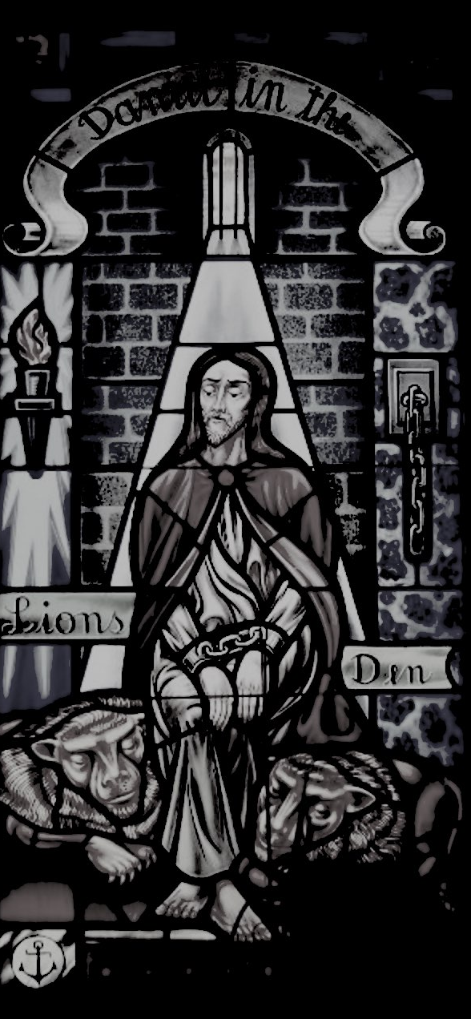
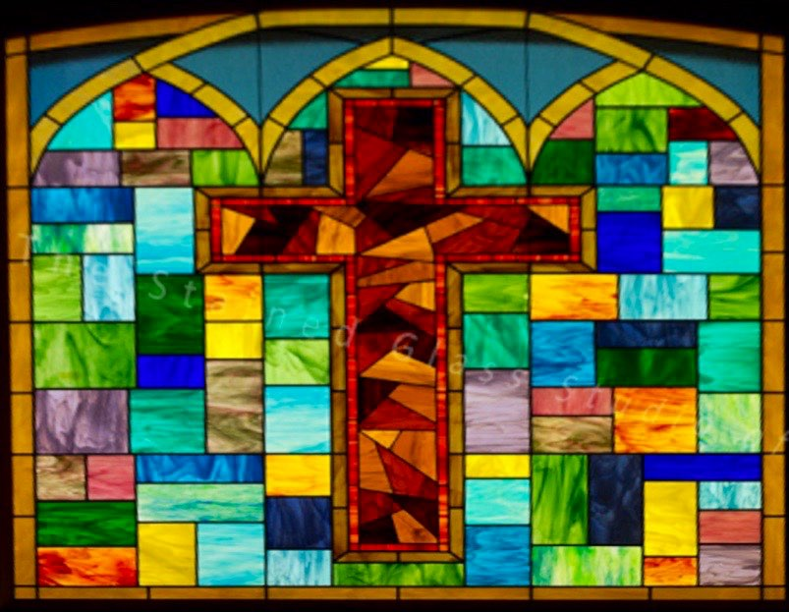
Daniel 7:14
And to him was given dominion and glory and a kingdom, that all peoples, nations, and languages should serve him; his dominion is an everlasting dominion, which shall not pass away, and his kingdom one that shall not be destroyed.

Slide 22
Daniel 7:14
And to him was given dominion and glory and a kingdom, that all peoples, nations, and languages should serve him; his dominion is an everlasting dominion, which shall not pass away, and his kingdom one that shall not be destroyed.
Luke 24:25
“Oh foolish ones, and slow of heart to believe all that the prophets have spoken!”
Luke 24:25
“Oh foolish ones, and slow of heart to believe all that the prophets have spoken!”

Slide 24
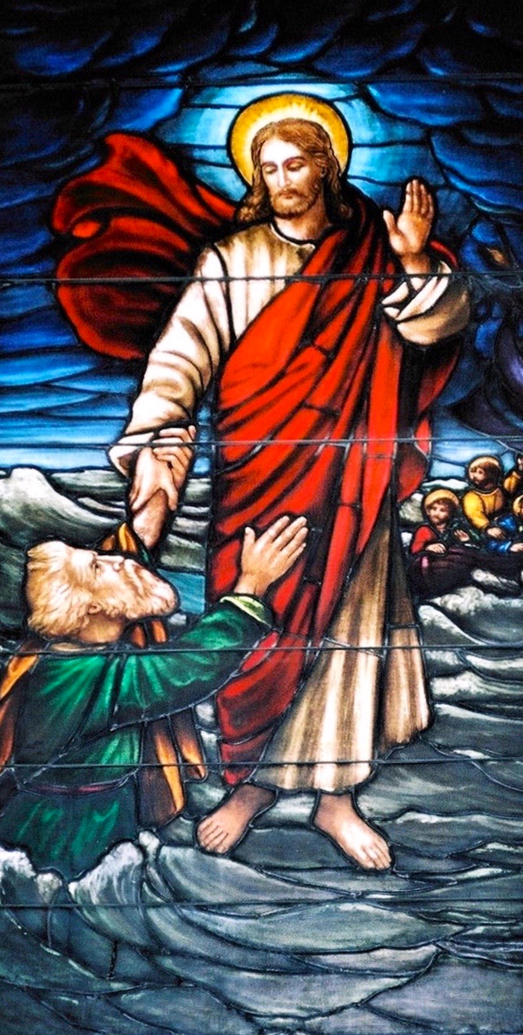
Matthew 14:31
“You of little faith,” He said,
“why did you doubt?”

Slide 25
Psalms 118:8
It is better to take refuge in the LORD than to trust in man.

